Slide 1
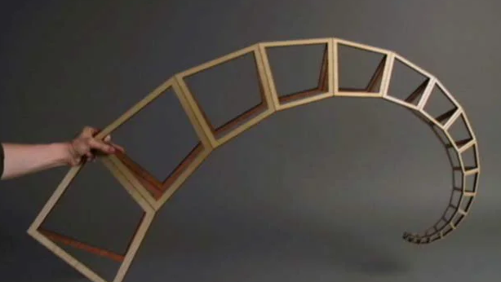
Curling Spiral (Outer Spine)
Tasks summary
Project folder on Github

Slide 2
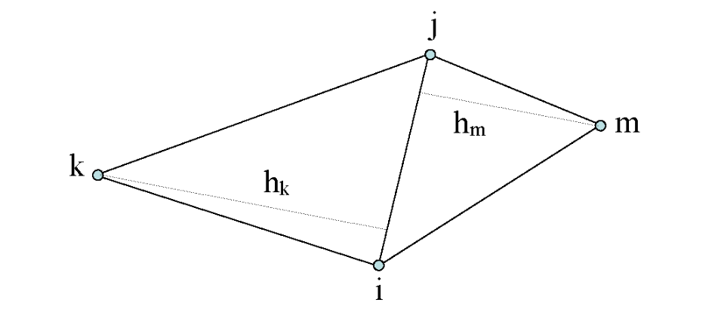
Geometric Definition & Parametric Requirements
Calculated 5 DOF by subtracting translational and rotational constraints from the total coordinate set (8 - 3 = 5).
Triangulation Method: Verified the result by decomposing the geometry into two adjacent triangles (3 + 2 parameters).
The shape is fully defined by specific combinations of the 5 DOF, such as:
4 Sides and 1 Angle
3 Sides and 2 Angles
2 Adjacent Sides and 3 Angles

Slide 3
Design Logic (Focus on parameters)
DOF Reduction: Simplified the available 5 degrees of freedom by fixing internal angles and applying a strict geometric reduction ratio.
Geometric Consistency: Achieved a self-similar logarithmic spiral by maintaining constant internal angles (alpha, beta = 80.41deg) while scaling dimensions from 50mm down to 11.88mm.

Slide 4
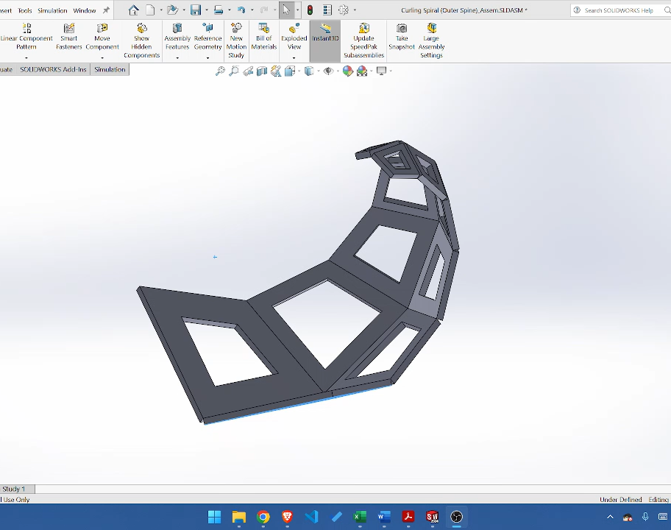
Design assembly
CAD Implementation: Modeled the calculated geometry in SolidWorks, extruding each quadrilateral segment to a uniform thickness of 2mm.
Constructed the primary chain by joining six quadrilaterals at their common edges to establish the base structure.
Symmetric Integration: Completed the profile by assembling a mirrored copy, replicating the motion dynamics of the John Edmark Curling Spiral (Outer Spine) framework.
.

Slide 5
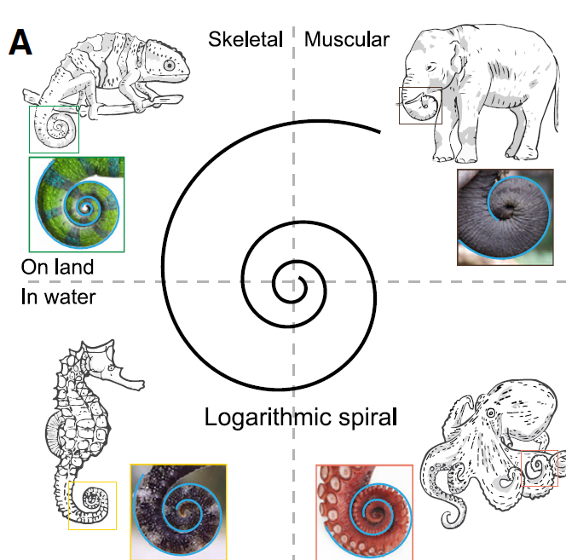
SpiRobs: Logarithmic spiral-shaped robots
The mechanism’s profile follows the polar equation
r = a.e^{(b.θ)}
Scale Factor (a): Defines the initial geometric size, correlating directly to the first quadrilateral dimension (50mm).
Expansion (b): A constant parameter that dictates the rate of expansion and the "tightness" of the spiral wrap.

Slide 6
Material Parameter
Type:
Emodulus
Viscosity

Slide 7
Abaqus instance

